Slide 1

Y-DATA: Yandex School of Data Analysis — 2021
Support Vector Machines
Lior Sidi & Efrat Egozi

Slide 2
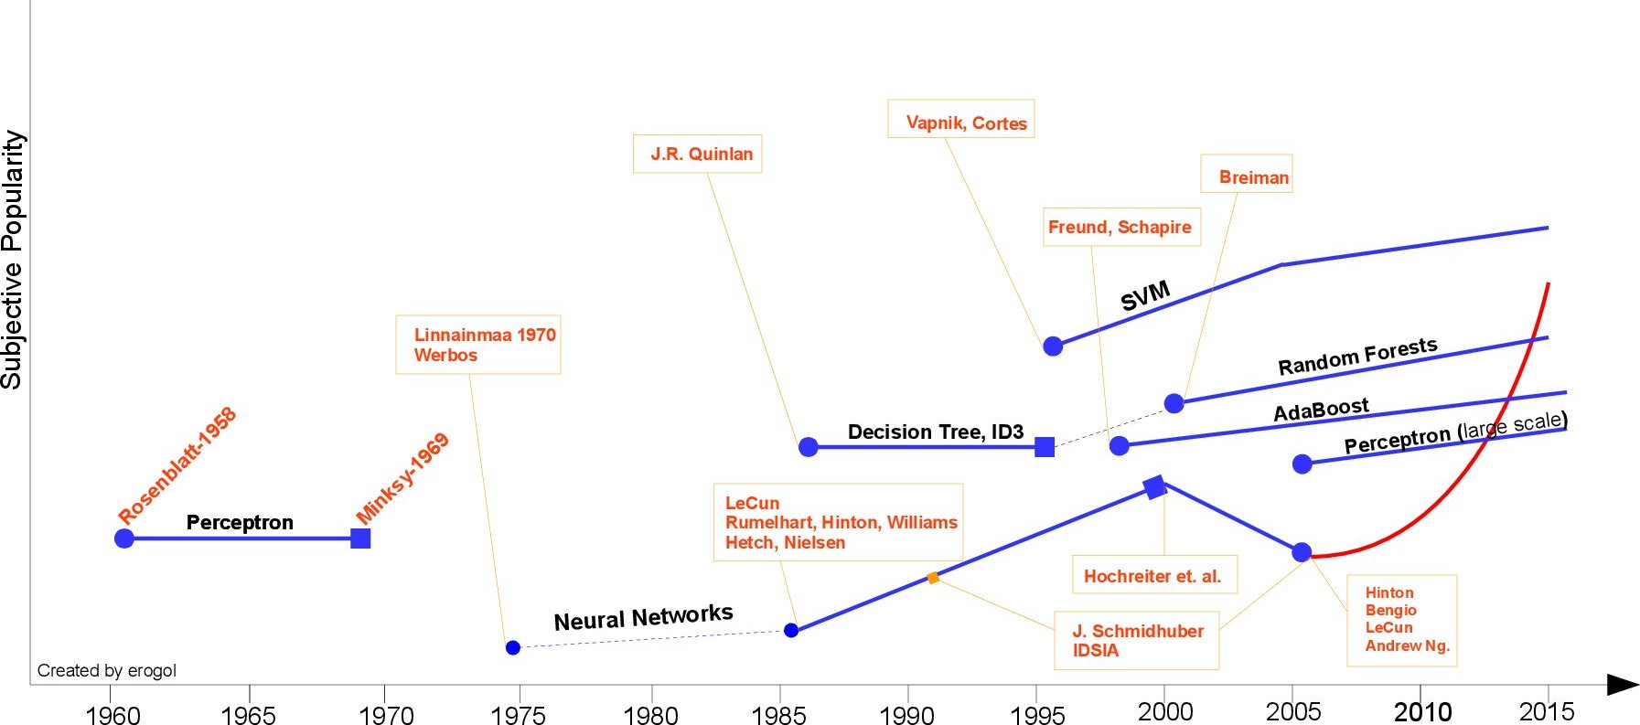
Models History

Slide 3
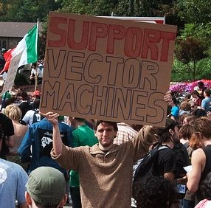
Motivation
Good for difficult problems with limited data (<10K data points)
Face Detection
Text Classification
Protein Fold and Remote Homology Detection
Handwriting Recognition

Slide 4
Linear Classification - 1 dim

Slide 5
Linear Classification - 2 dim
X1
w1*x1 = w2*x2 + b
2*x1 = 4*x2 - 3
2*x1 - 4*x2 + 3 = 0
X2

Slide 6
Linear Classification - 2 dim
X1
w1*x1 = w2*x2 + b
2*x1 = 4*x2 - 3
2*x1 - 4*x2 + 3 = 0
2*3 - 4*5 + 3 =
3
X2
5

Slide 7
Linear Classification - 2 dim
X1
w1*x1 = w2*x2 + b
2*x1 = 4*x2 - 3
2*x1 - 4*x2 + 3 = 0
-11
2*3 - 4*5 + 3 = 6 - 20 + 3 = -11
3
X2
5

Slide 8
Linear Classification - 2 dim
X1
w1*x1 = w2*x2 + b
10
2*x1 = 4*x2 - 3
2*x1 - 4*x2 + 3 = 0
2*3 - 4*5 + 3 = 6 - 20 + 3 = -11
2*10 - 4*2 + 3 = 20 - 8 + 3 = 15
X2
2

Slide 9
Linear Classification - 2 dim
X1
w1*x1 = w2*x2 + b
10
2*x1 = 4*x2 - 3
2*x1 - 4*x2 + 3 = 0
15
2*3 - 4*5 + 3 = 6 - 20 + 3 = -11
2*10 - 4*2 + 3 = 20 - 8 + 3 = 15
X2
2

Slide 10
Linear Classification - 2 dim
w1*x1 = w2*x2 + b
f(X,W) = w1*x1 + w2*x2 =
For simplicity We are going to eliminate the bias term Which can be added as a vectors of ones

Slide 11
Linear Classification - 2 dim
w1*x1 = w2*x2 + b
f(X,W) = w1*x1 + w2*x2 =
= 𝚺WX = WᵗX = 0
=> sign(WX)
For simplicity We write
WᵗX as WX

Slide 12
Linear Classification
f(X,W) = sign(WX)

Slide 13
Linear Classification
f(X,W) = sign(WX)

Slide 14
Linear Classification
f(X,W) = sign(WX)
Why is this seems as a good separator?

Slide 15
Classifier Margin
A margin in linear classifiers is the boundary width the touches the datapoint

Slide 16
Maximum margin
A maximum margin in linear classifiers is the Max boundary width the touches the datapoint

Slide 17
Maximum Margin
A maximum margin in linear classifiers is the Max boundary width the touches the datapoint
The points on the margins are called Support Vectors
VC dimension can show that the maximum margin is a good approach to linearly separable problems.
Support Vectors

Slide 18
Classifier margine
A maximum margin in linear classifiers is the Max boundary width the touches the datapoint
The points on the margins are called Support Vectors
VC dimension can show that the maximum margin is a good approach to linearly separable problems.
Allows a more flexibility around the decision boundary

Slide 19

Hard SVM
A distance of datapoint i can be defined by
w
L
x
y is the point label which can be 1 or -1

Slide 20

Hard SVM
A distance of datapoint i can be defined by
w
L
x
The support vectors has the minimum margin

Slide 21
Hard SVM
A distance of datapoint i can be defined by
w
L
x
The support vectors has the minimum margin
We want to find the w that maximize the margin

Slide 22


Hard SVM
A distance of datapoint i can be defined by
w
L
x
The support vectors has the minimum margin
We want to find the w that maximize the margin
Add ||w|| to constraint the w scaling
Define a margin that not depends on the scale of w

Slide 23


Slide 24
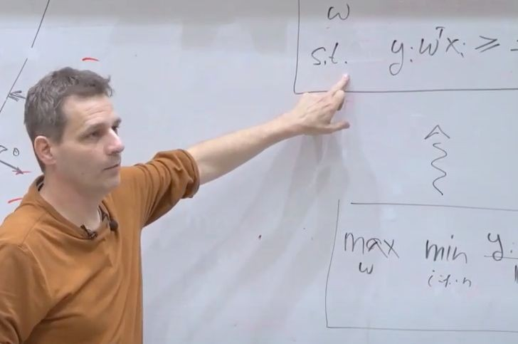
equivalent to
https://youtu.be/LceLJvKMbBk?t=3613
*Assumes full separability (1.1 in HW)

Slide 25

What if there is no linear separability?

Slide 26




Soft SVM - Supporting error data points

Slide 27
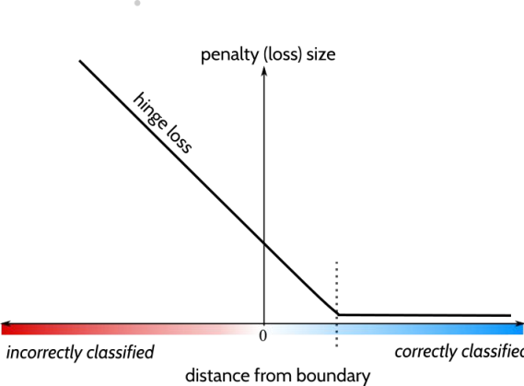


Soft SVM - Supporting error data points

Slide 28
Soft SVM - Supporting error data points
regularization objective
But came from problem definition

Slide 29
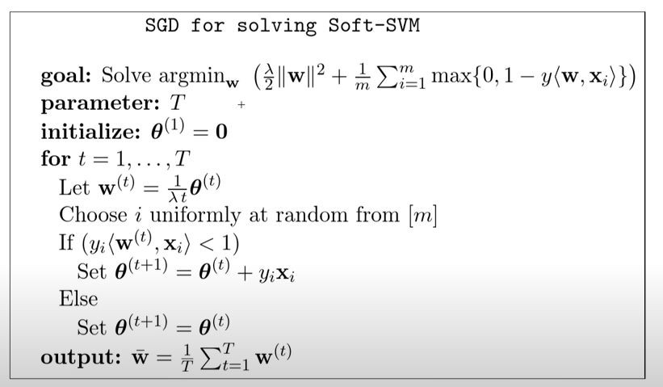
How we can solve it?
Gradient descent Quadratic Programing
https://leon.bottou.org/publications/ pdf/lin-2006.pdf

Slide 30
Homework
Implementing SVM called Pegasos (2011) - 55 (+ 10 bonus)
Implement Class - 35
Test - 10
Analyze param - 5
Analyze learning - 5
Mini-batch bonus - 10*
The effect of imbalance on SVM - 15
Practical SVM in scikit-learn & hypertune - 10 Using different Kernels - 20
4.

Slide 31
Another Way to Solve SVM
And other tricks

Slide 32
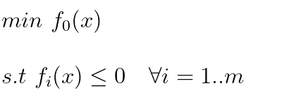
From Primal to Dual
Primal
Original SVM definition

Slide 33
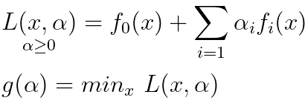
From Primal to Dual
Primal
Dual
Original SVM definition
Dual definition that solvable with linear solvers

Slide 34





From Primal to Dual
Primal
Dual
Original SVM definition
Dual definition that solvable with linear solvers

Slide 35
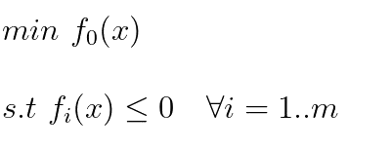
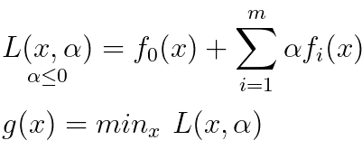

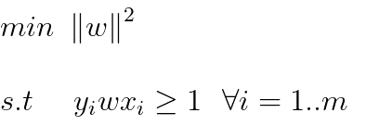
From Primal to Dual
Primal
Dual
SVM
definition

Slide 36
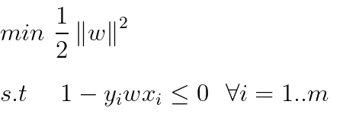
From Primal to Dual
Primal
Dual
SVM
definition
Modify

Slide 37
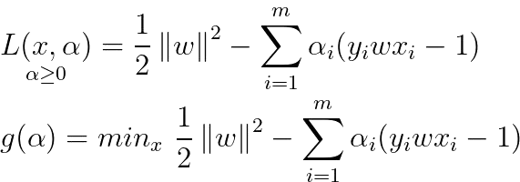
From Primal to Dual
Primal
Dual
SVM
definition
Modify

Slide 38
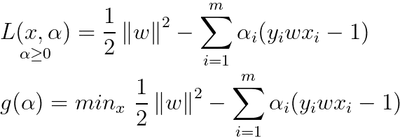
From Dual to Primal

Slide 39

From Dual to Primal

Slide 40
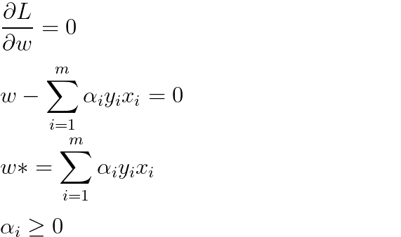
From Dual to Primal

Slide 41


Lagrange coefficients for each sample in the training set
All possible pairs in the training set
Optimization Definition
Constraints

Slide 42

Optimization Definition
Constraints
Back to Primal

Slide 43

Optimization Definition
Constraints
Back to Primal
Predict

Slide 44

Optimization Definition
Constraints
Back to Primal
Predict

Slide 45
Applying
?

Slide 46
Applying
Reminds you something?
?

Slide 47
Dealing with non-linearity
How to separate with linear classifier?
x1

Slide 48
Dealing with non-linearity
How to separate with linear classifier?
x1

Slide 49

Dealing with non-linearity
How to separate with linear classifier?
x2
Use non-linear transformation
x1

Slide 50
Dealing with non-linearity
x2
x1

Slide 51
Dealing with non-linearity
x2
x1
x3

Slide 52
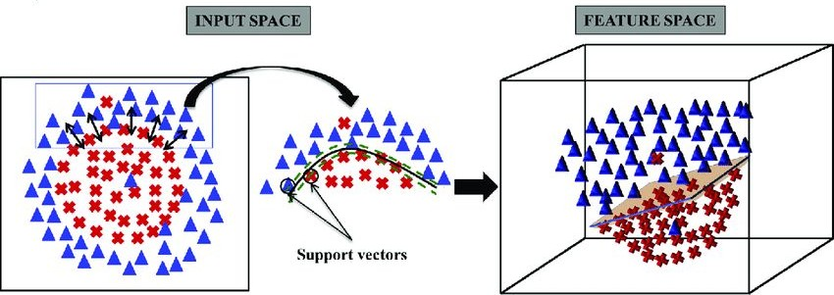

Slide 53
Dealing with non-linearity
How to separate with linear classifier?
x2
A capital X = a datapoint
x1
x3

Slide 54
The Kernel Trick
To support this transformation We would need to compute all these features for each sample

Slide 55

The Kernel Trick
To support this transformation We would need to compute all these features for each sample
The Solution: the Kernel trick!
Use a dot product in feature space can be computed as kernel function

Slide 56

The Kernel Trick

Slide 57
The Kernel Trick
We would need to compute all these features!
The Solution: the Kernel trick!
Use a dot product in feature space can be computed as kernel function
Where do we have dot product in SVM?

Slide 58
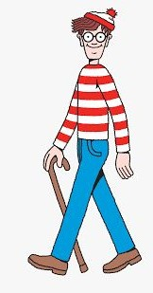
Optimization Definition
Constraints
Back to Primal
Predict

Slide 59

Optimization Definition
Constraints
Back to Primal
Predict

Slide 60
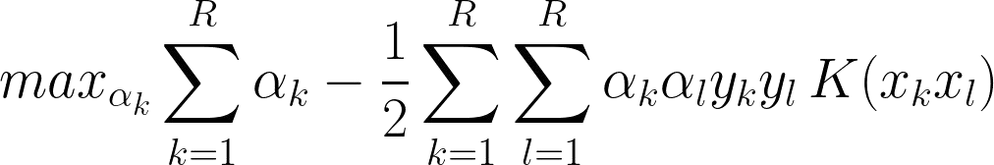
Optimization Definition
Constraints
Back to Primal
Predict

Slide 61
Optimization Definition
We still need to
compute all the kernels pairs, but we don’t need to maintain the feature
Constraints
space
Back to Primal
Predict

Slide 62

Good Kernel Functions for SVM
On top the polynomial kernel function there are more suitable ones:
Radial Basis Function (RBF):
Tanh Function (nn):

Slide 63
Good Kernel Functions for SVM
On top the polynomial kernel function there are more suitable ones:
Radial Basis Function (RBF):
Tanh Function (nn):
hypertune

Slide 64
SVM Pros & Cons
Good
Learn many non linear pattern
Pick "conservative" hypotheses, that are less likely to overfit the data,
Good for Small datasets with though target pattern
“Only” 2 params - C, Kernel Function

Slide 65
SVM Pros & Cons
Good
Learn many non linear pattern
Pick “conservative” hypotheses, that are less likely to overfit the data,
Good for Small datasets with though target pattern
“Only” 2 params - C, Kernel Function
Bad
O(n^2-3) runtime depends on C and the kernel (n number of datapoints)
O(n^2) memory to compute all the pairwise kernels - 5-10K datapoints
different values for the Kernel prams

Slide 66
Q&A

Slide 67
https://winvector.github.io/margin/margin.pdf https://youtu.be/LceLJvKMbBk?t=7311 https://youtu.be/fB47g3QM0sk?t=839
VC Dimension - https://www.youtube.com/watch?v=puDzy2XmR5c
Shalev-Shwartz, S., Singer, Y., Srebro, N., & Cotter, A. (2011). Pegasos: Primal estimated sub-gradient solver for svm. Mathematical programming, 127(1), 3-30. [[pdf](http://www.ee.oulu.fi/research/imag/courses/Vedaldi/ShalevSiSr07.pdf)]
Schölkopf, B., Williamson, R. C., Smola, A. J., Shawe-Taylor, J., & Platt, J. C. (2000). Support vector method for novelty detection. In Advances in neural information processing systems (pp. 582-588).
[[pdf](http://papers.nips.cc/paper/1723-support-vector-method-for-novelty-detection.pdf)]
Livni, R., Crammer, K. & Globerson, A.. (2012). A Simple Geometric Interpretation of SVM using Stochastic Adversaries. Proceedings of the Fifteenth International Conference on Artificial Intelligence and Statistics, in PMLR 22:722-730. [[pdf](http://proceedings.mlr.press/v22/livni12/livni12.pdf)]

Slide 68
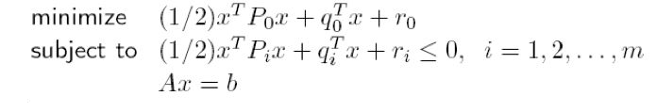
From Primal to Dual

Slide 69
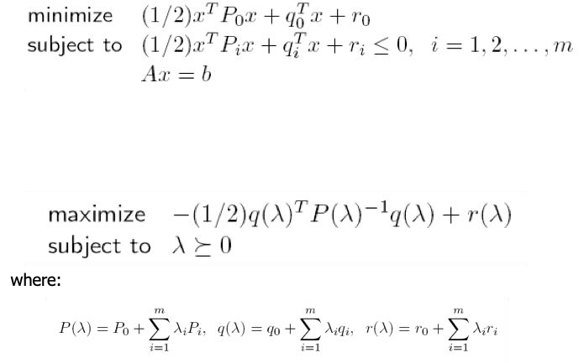
From Primal to Dual
Works in convex problems Transform the problem from minimize to maximize
Use lagrange coefficients

Slide 70
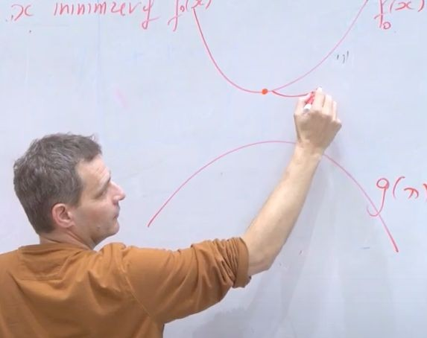
From Primal to Dual
Works in convex problems Transform the problem from minimize to maximize
Use lagrange coefficients
https://youtu.be/LceLJvKMbBk?t=7311 https://youtu.be/fB47g3QM0sk?t=839

